Slide 1


智冠科技 數位發展中心
Google Cloud Platform Tutorial
智冠科技

Slide 2
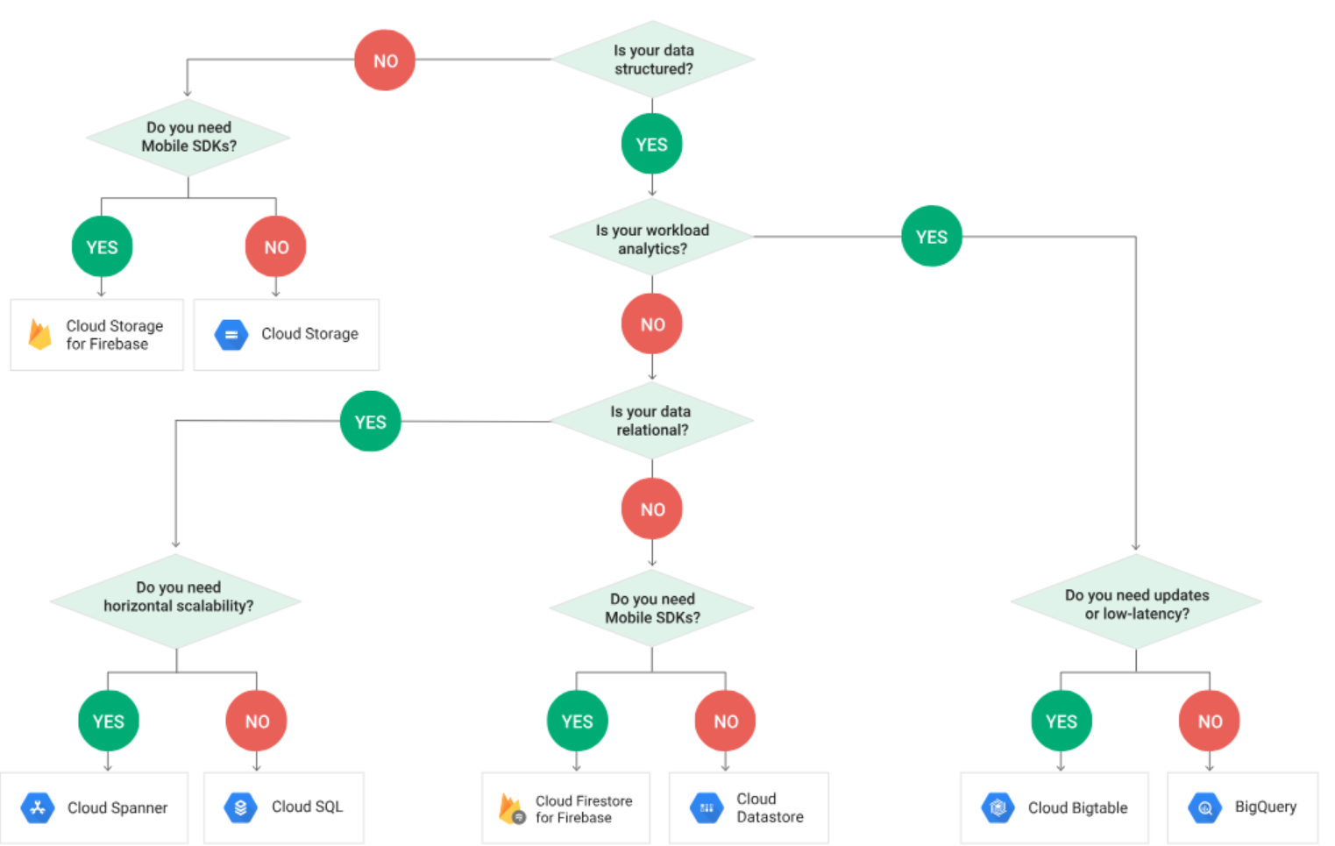

Slide 3

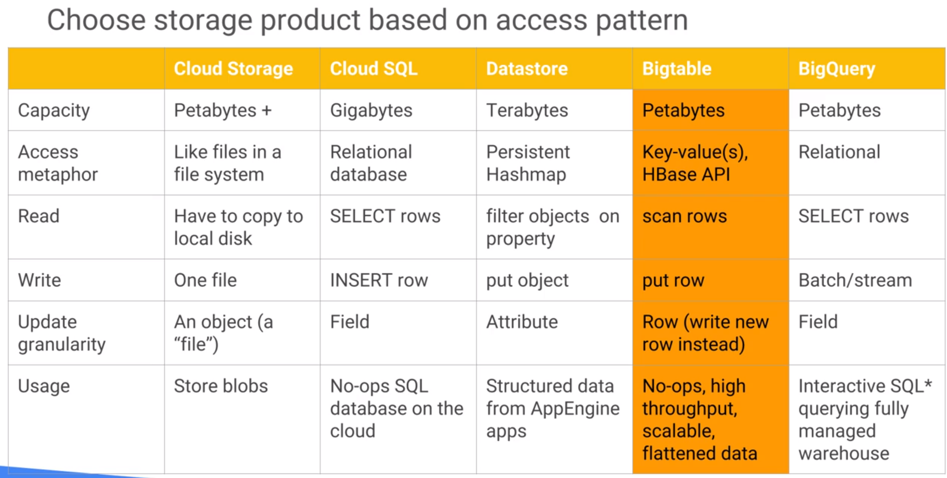
Bigtable, high throughput need, flatten data 1*N
fit time series
cbt

Slide 4
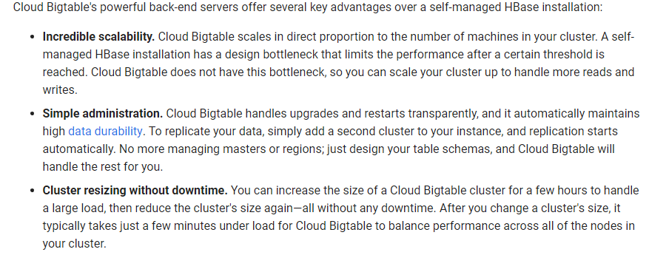
Big Table Document
Big Table

Slide 5
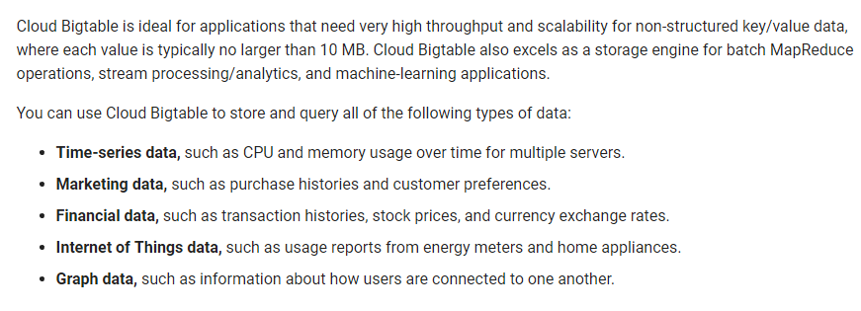
Big Table Document
Big Table

Slide 6
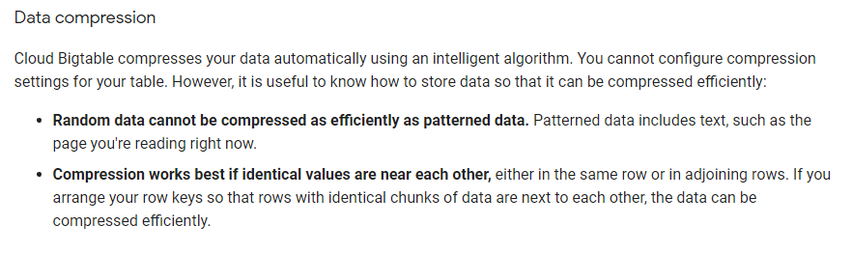
Big Table Document
Big Table

Slide 7
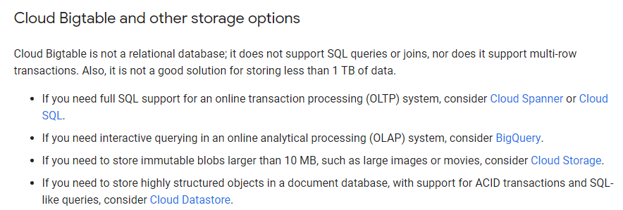
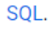
Big Table Document
Big Table

Slide 8
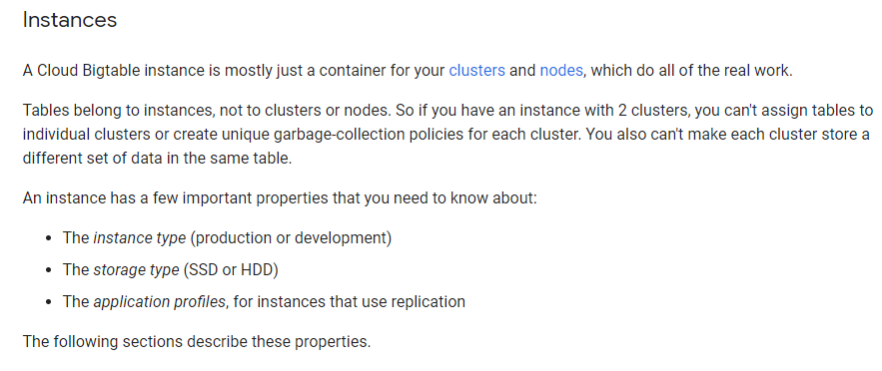
Big Table Document
Big Table

Slide 9
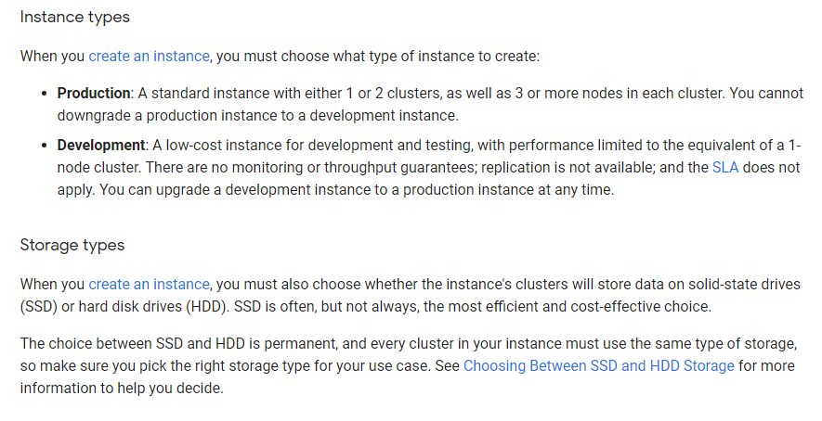
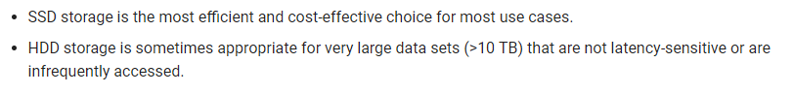
Big Table Document
Big Table
up to 2 clusters in 1 instance
Cluster
N
N
N
Cluster
N

Slide 10
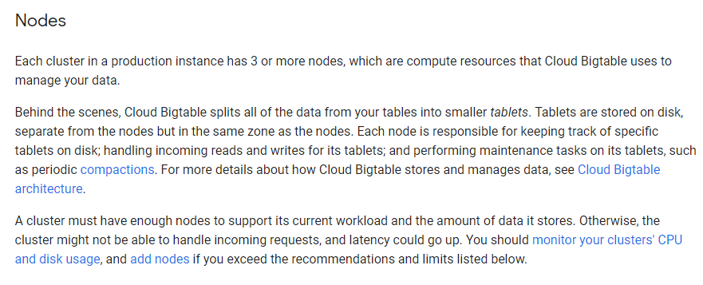
Big Table Document
Big Table
Cluster
N
N
N

Slide 11
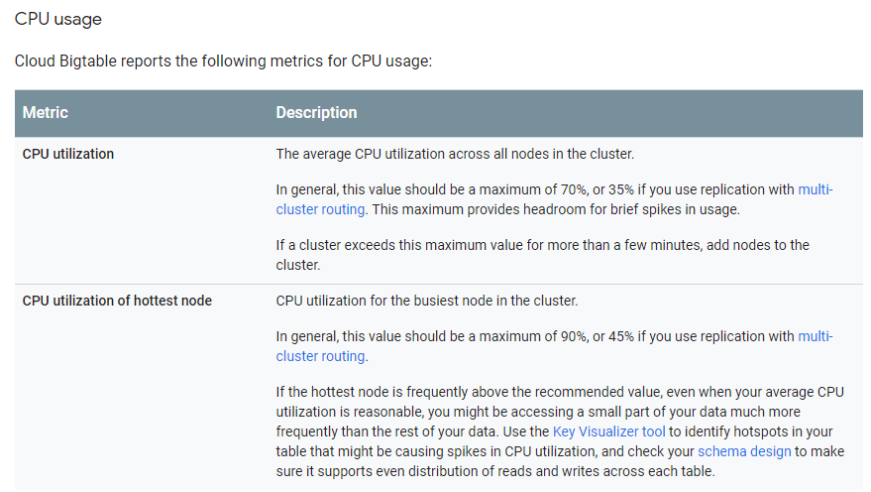
Big Table Document
Big Table

Slide 12
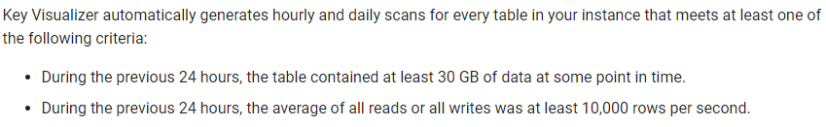
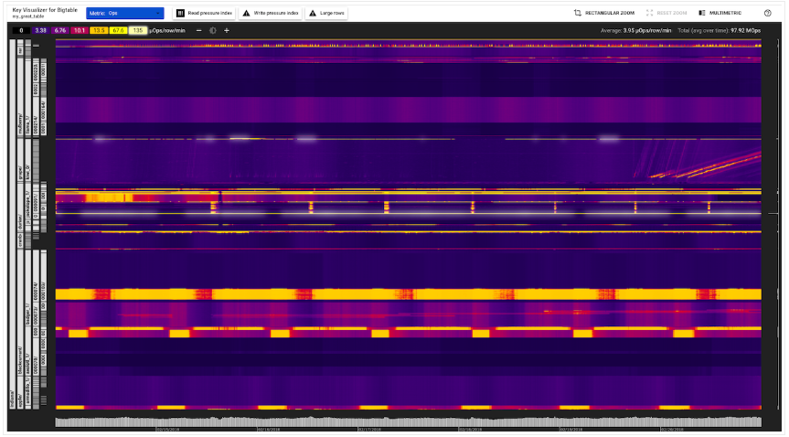
Big Table Document
Big Table

Slide 13
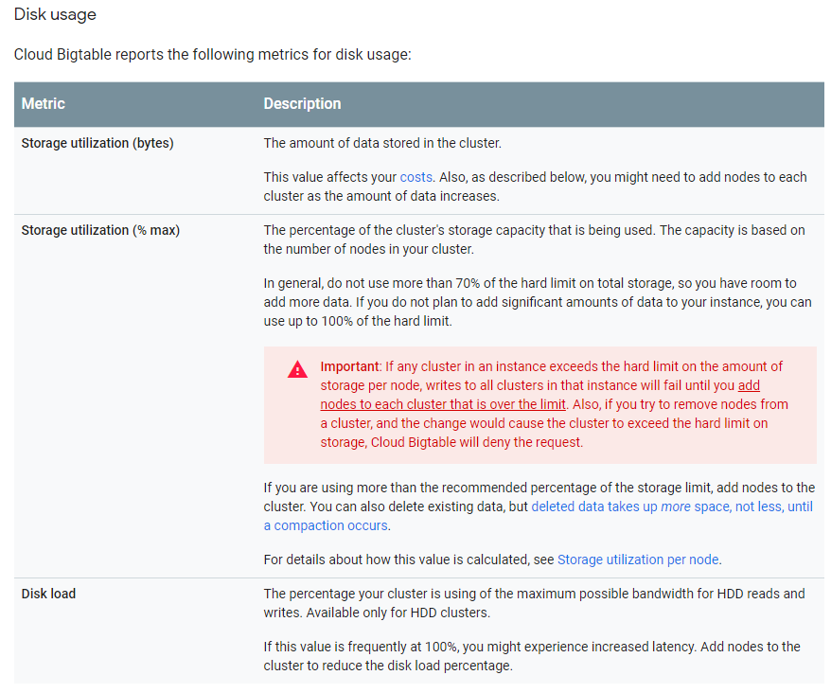
Big Table Document
Big Table

Slide 14
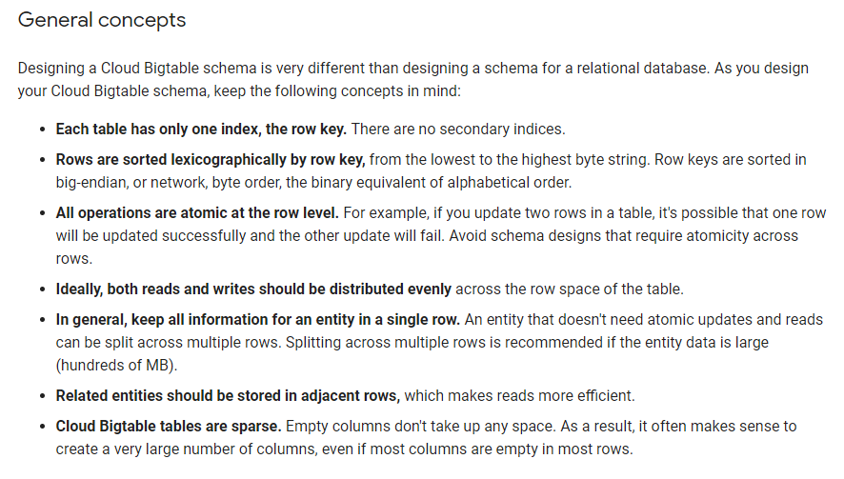
Big Table Document
Big Table
字典順序

Slide 15
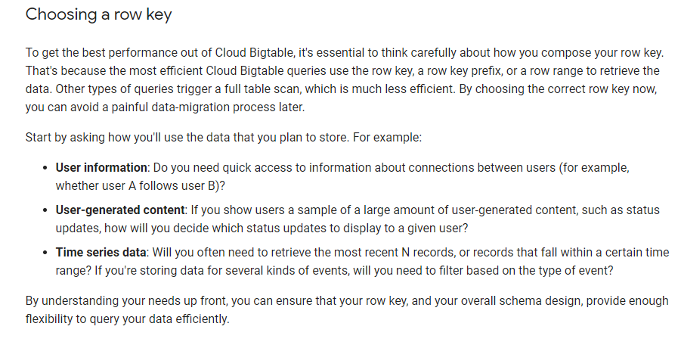
Big Table Document
Big Table

Slide 16
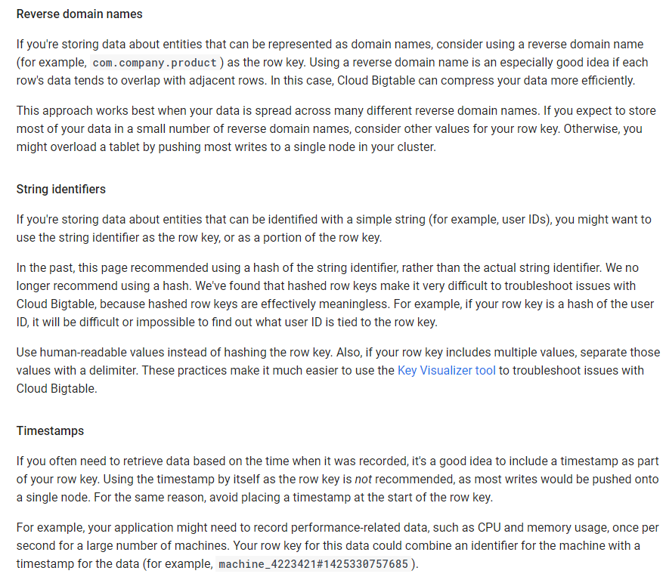
Big Table Document
Big Table

Slide 17
Big Table Document
Big Table

Slide 18
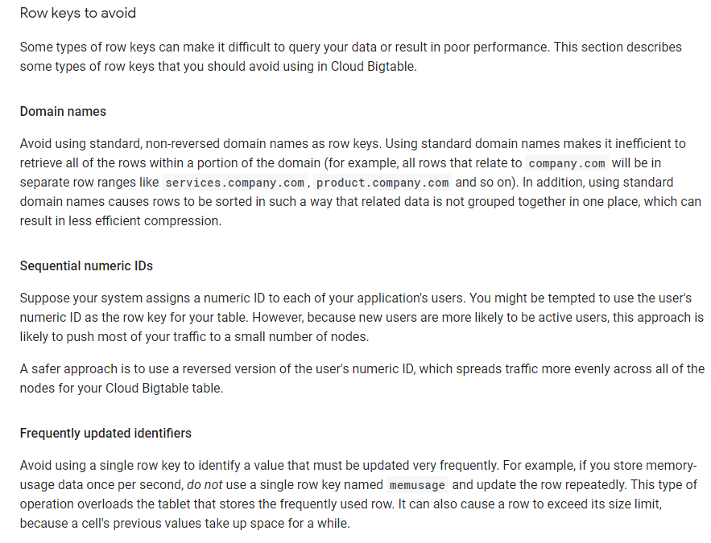
Big Table Document
Big Table

Slide 19
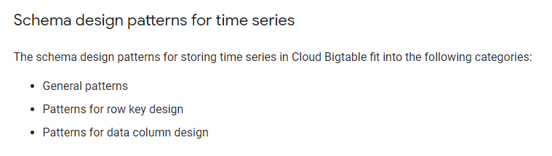
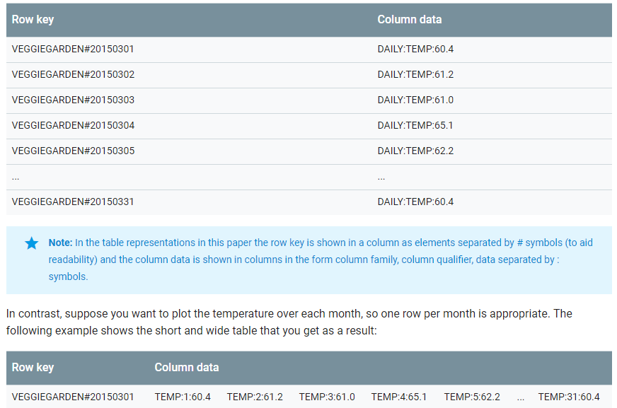
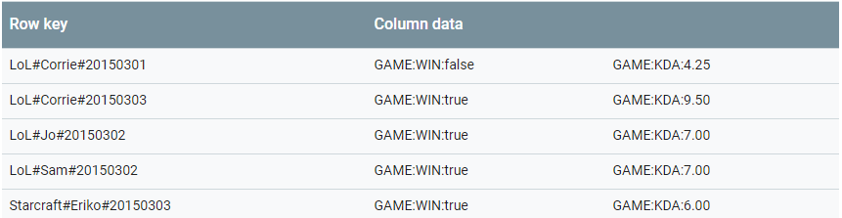
Big Table Document
Big Table

Slide 20
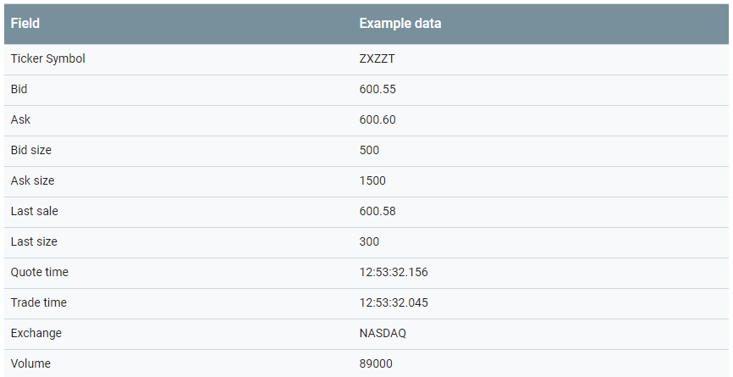
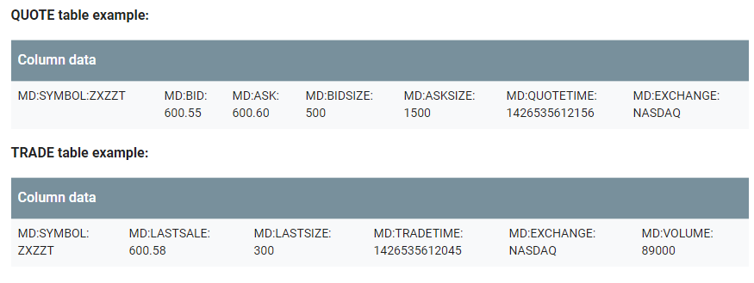
Big Table Document
Big Table

Slide 21
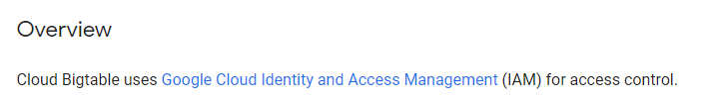
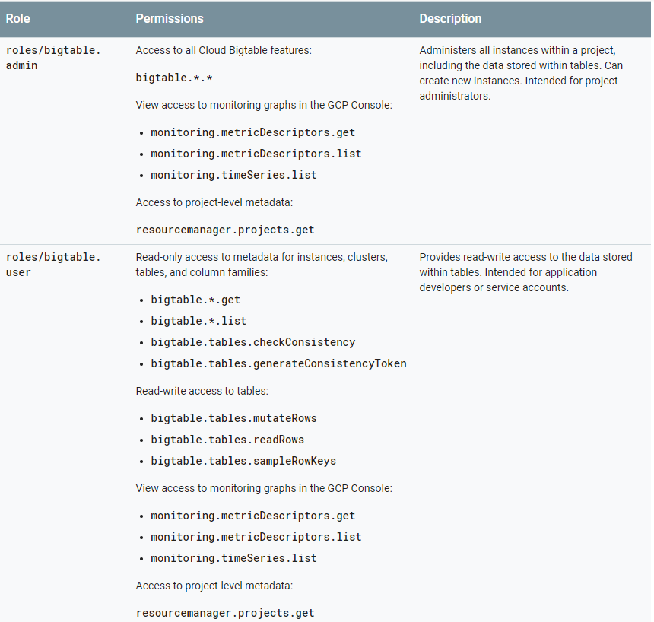
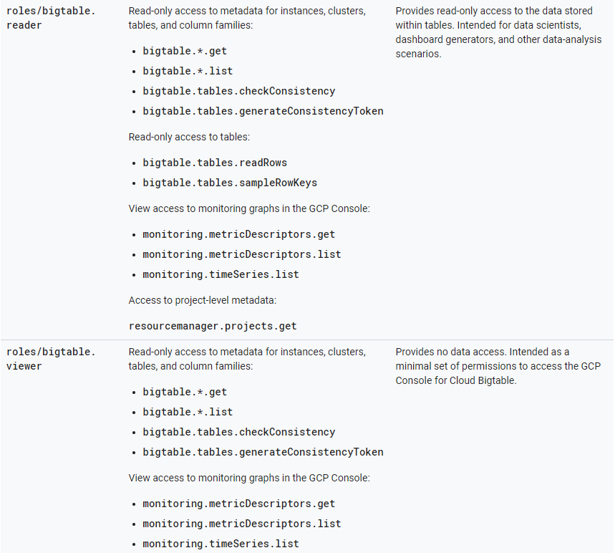
Big Table Document
Big Table

Slide 22
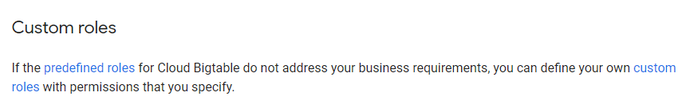
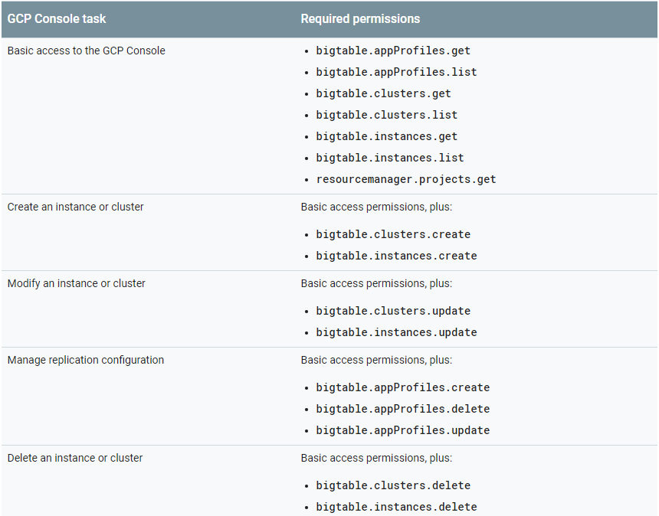
Big Table Document
Big Table

Slide 23
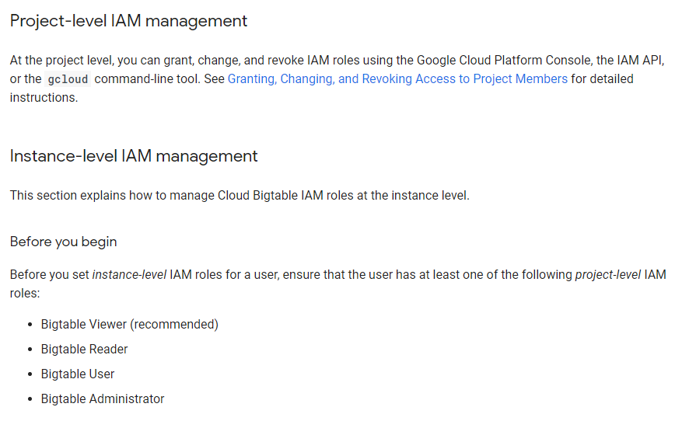
Big Table Document
Big Table

Slide 24
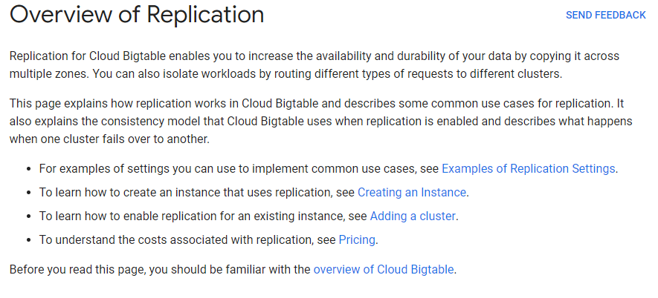
Big Table Document
Big Table

Slide 25
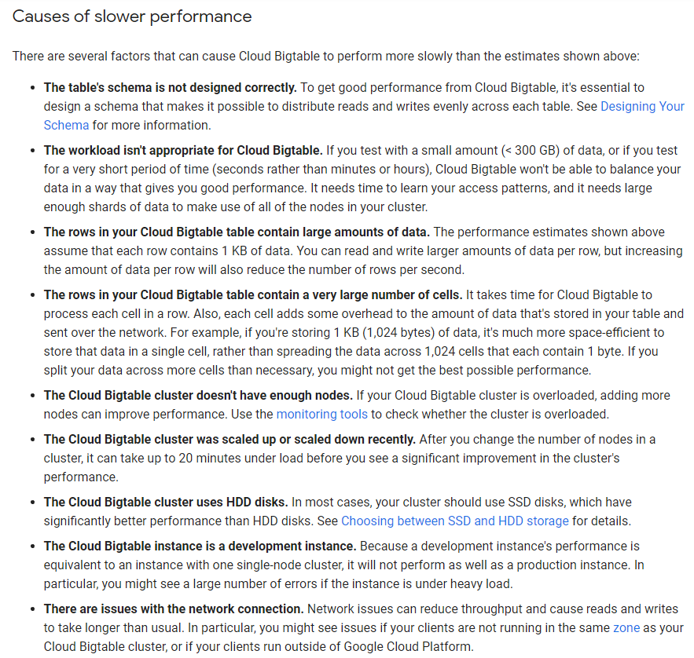
Big Table Document :
Big Table

Slide 26
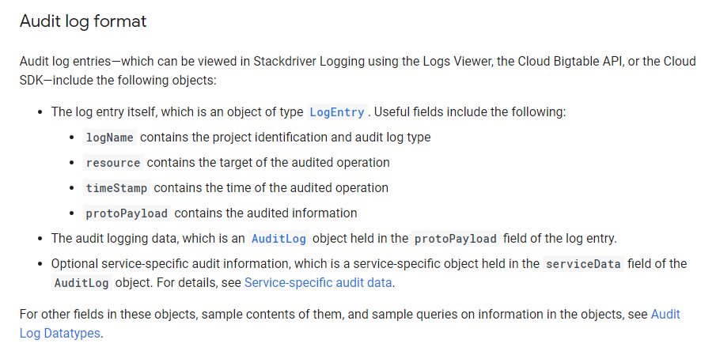
Big Table Document
Big Table

Slide 27
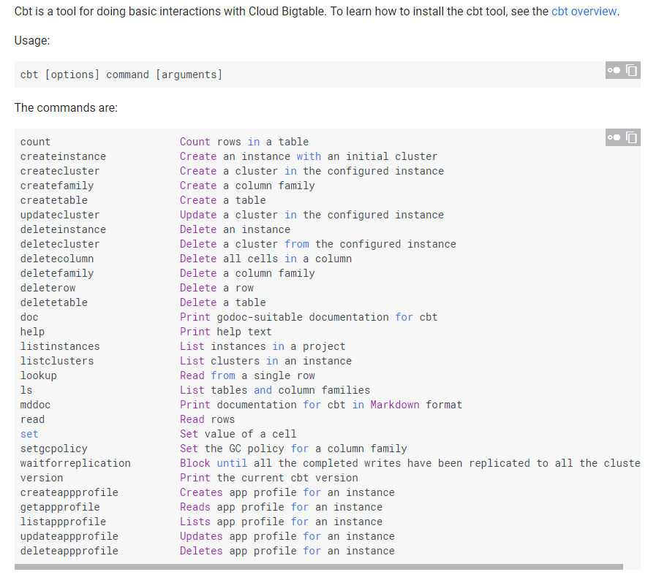
Big Table Document
Big Table

Slide 28

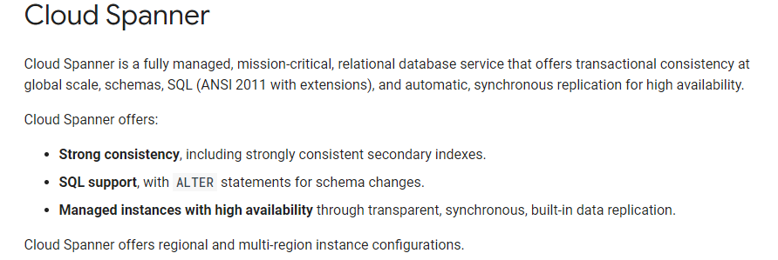
Cloud Spanner
Big Table
OLTP

Slide 29
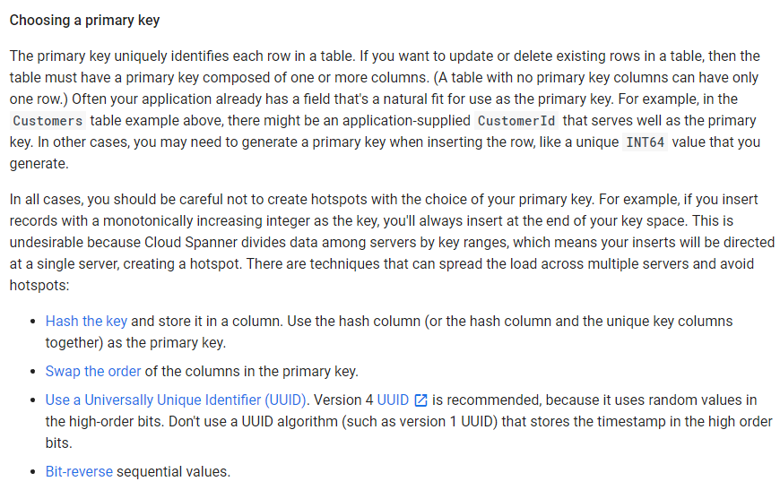
Cloud Spanner
Big Table

Slide 30
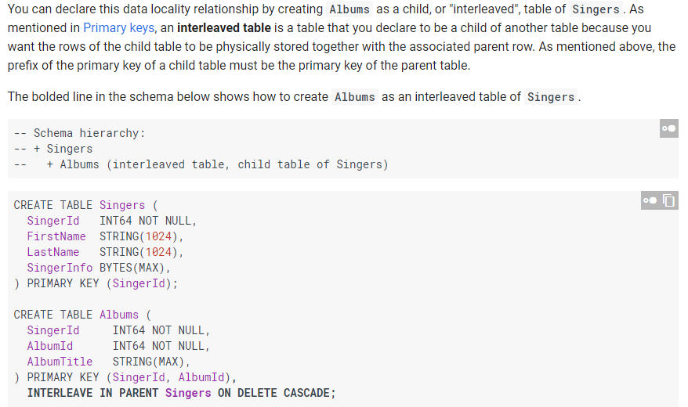
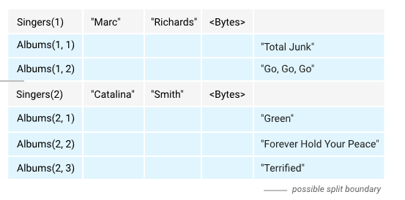
Cloud Spanner
Big Table

Slide 31
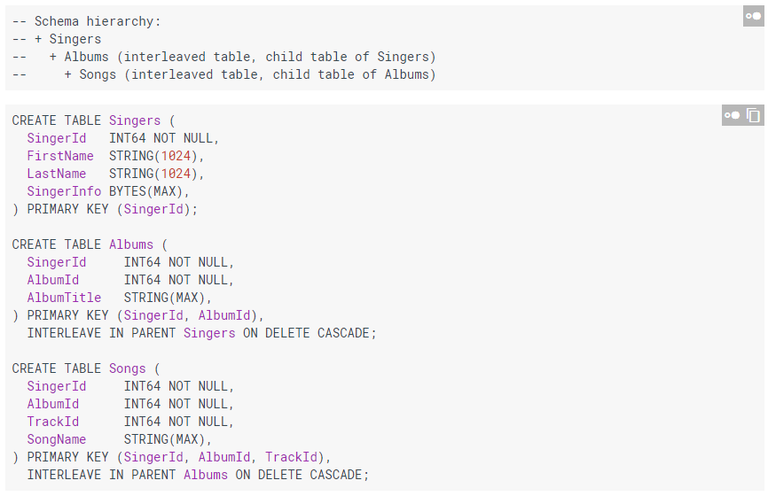
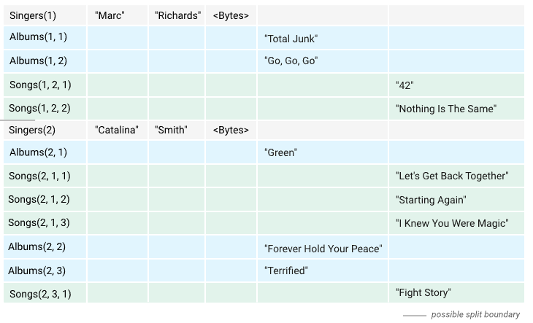
Cloud Spanner
Big Table

Slide 32
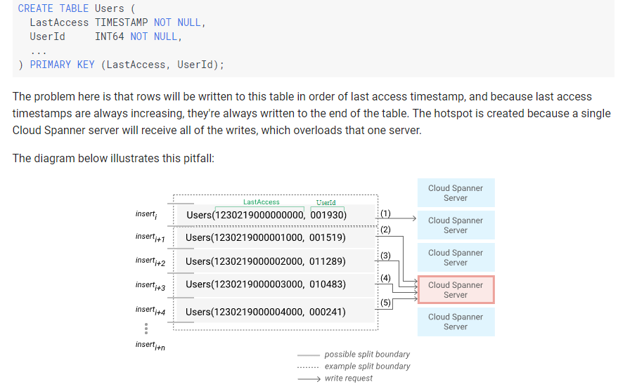
Cloud Spanner
Big Table

Slide 33
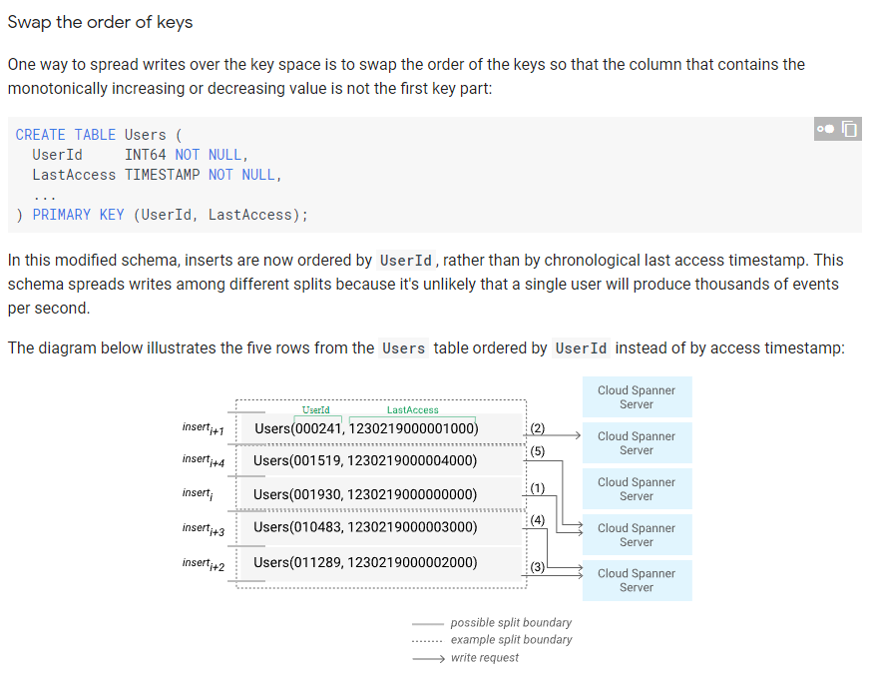
Cloud Spanner
Big Table

Slide 34
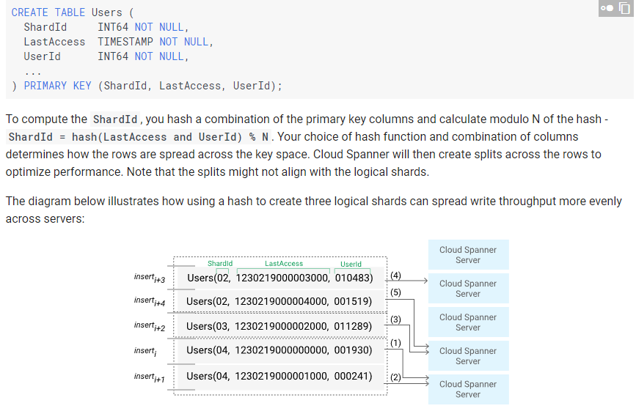
Cloud Spanner
Big Table

Slide 35
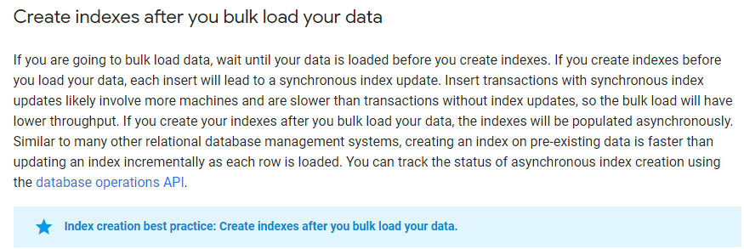
Cloud Spanner
Big Table

Slide 36
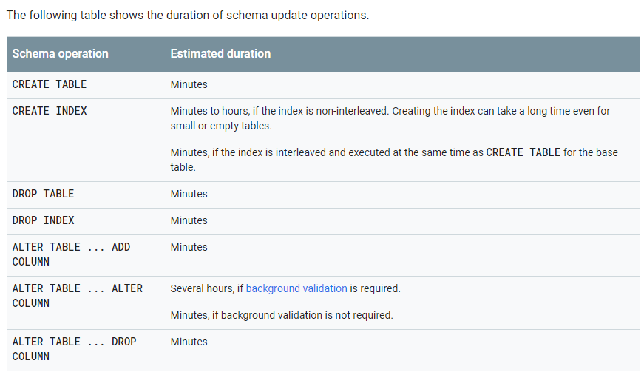
Cloud Spanner
Big Table

Slide 37
Cloud Spanner
Big Table

Slide 38
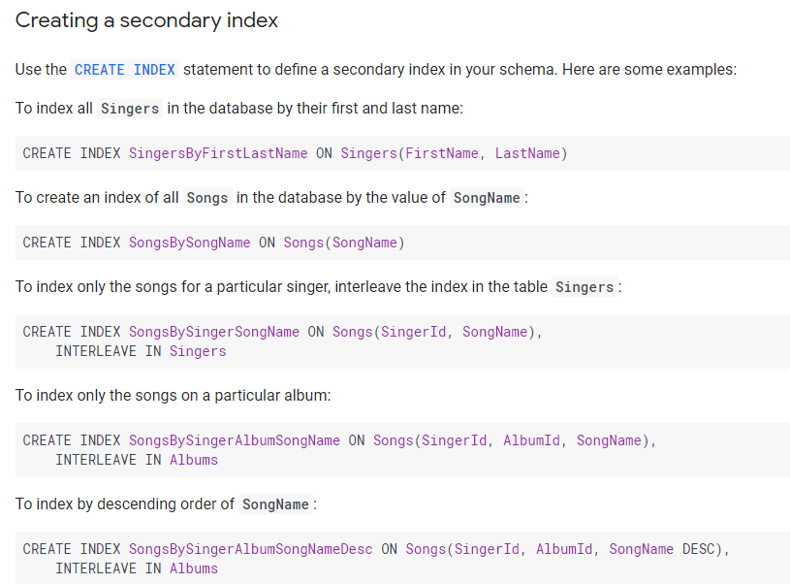
Cloud Spanner
Big Table

Slide 39
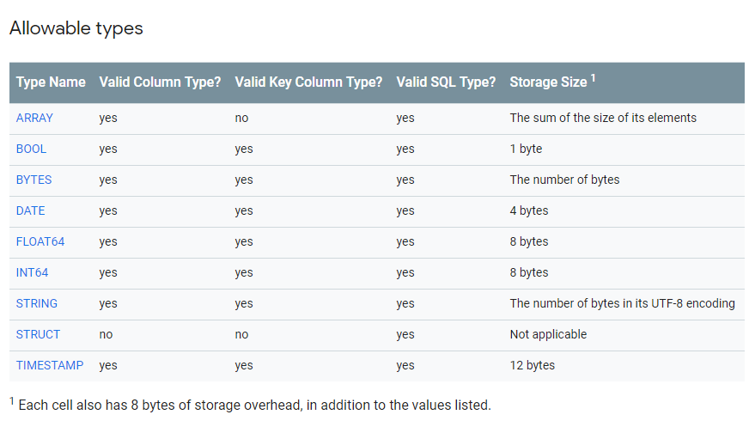
Cloud Spanner
Big Table

Slide 40
Cloud Spanner
Big Table

Slide 41
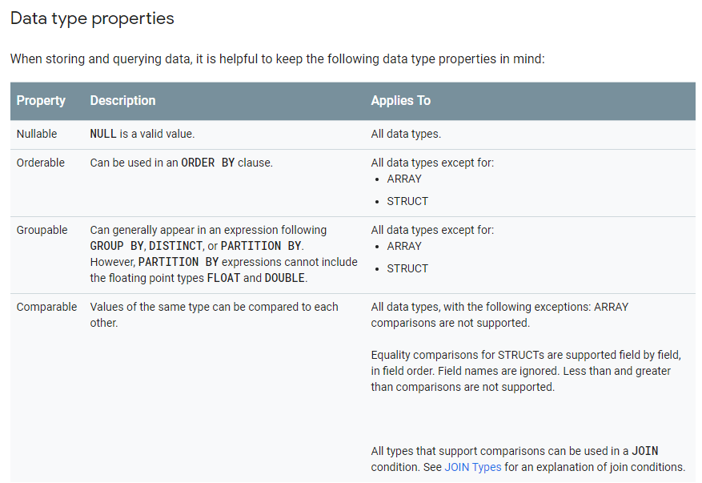
Cloud Spanner
Big Table

Slide 42
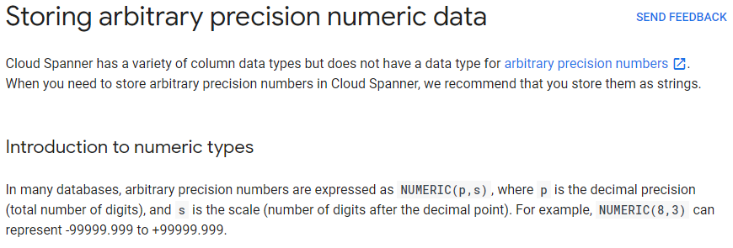
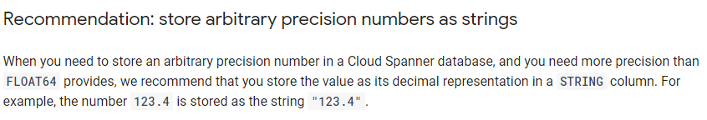
Cloud Spanner
Big Table

Slide 43


Cloud Spanner
Big Table

Slide 44

Cloud Spanner
Big Table

Slide 45

Cloud Spanner
Big Table

Slide 46


Cloud Spanner
Big Table

Slide 47

Cloud Spanner
Big Table

Slide 48

Cloud Spanner
Big Table

Slide 49

Cloud Spanner
Big Table

Slide 50

Cloud Spanner
Big Table

Slide 51

Cloud Spanner
Big Table

Slide 52


Cloud Spanner
Big Table

Slide 53

Cloud Spanner
Big Table

Slide 54

Cloud Spanner
Big Table

Slide 55
Cloud Spanner
Big Table

Slide 56

Cloud Spanner
Big Table

Slide 57

Cloud Spanner
Big Table

Slide 58

Cloud Spanner
Big Table

Slide 59

Cloud Spanner
Big Table

Slide 60

Cloud Spanner
Big Table

Slide 61


Cloud Spanner
Big Table

Slide 62

Cloud Spanner
Big Table

Slide 64


GCP, Step 2, Choose One Solution to Store Data: Cloud SQL, RDB for gigabytes

Slide 65

GCP, Step 2, Choose One Solution to Store Data: Cloud SQL , RDB for gigabytes
Cons：
Use RDB schema to show OO Data, Hierarchical, NULL is needed to fill in the column which leads to data integrity problems

Slide 66

Cloud SQL
Big Table

Slide 67

Cloud SQL
Big Table

Slide 68

Cloud SQL
Big Table

Slide 69

Cloud SQL
Big Table

Slide 70

Cloud SQL
Big Table

Slide 71

Cloud SQL
Big Table

Slide 72

Cloud SQL
Big Table

Slide 73
Cloud SQL
Big Table

Slide 74

Cloud SQL
Big Table

Slide 75

GCP, Step 2, Choose One Solution to Store Data: BigQuery, Datawarehouse solution

Slide 76

BigQuery
Big Table

Slide 77

BigQuery
Big Table

Slide 78

BigQuery
Big Table

Slide 79
BigQuery
Big Table

Slide 80

BigQuery
Big Table

Slide 81

BigQuery
Big Table

Slide 82

BigQuery
Big Table

Slide 83

BigQuery
Big Table

Slide 84


BigQuery
Big Table

Slide 85
BigQuery
Big Table

Slide 86

BigQuery
Big Table

Slide 87


BigQuery
Big Table

Slide 88

BigQuery
Big Table

Slide 89

BigQuery
Big Table

Slide 90



BigQuery
Big Table

Slide 91


BigQuery
Big Table

Slide 92

BigQuery
Big Table

Slide 93

BigQuery
Big Table

Slide 95

ML concept
Machine Learning

